Slide 1
GirlSMART Summer Presentation 2014 Phonics To Reader’s Theater
Venetia Valley
Pre-K – 8 School

Slide 2
We Are The Lorax! Strong, Smart Bold

Slide 3
Prior Knowledge
After reading aloud Dr. Suess, The Lorax, students reviewed practicing reading short paragraphs taken from the book.
Prior to reading selected paragraphs, students worked together (whole class) to search for and identify targeted letter sounds found within words.
Words with these letters were then highlighted or circled to bring attention to these letters and sounds within the text

Slide 4
Looking for /or/, /ar/, and /er/!

Slide 5
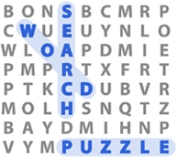
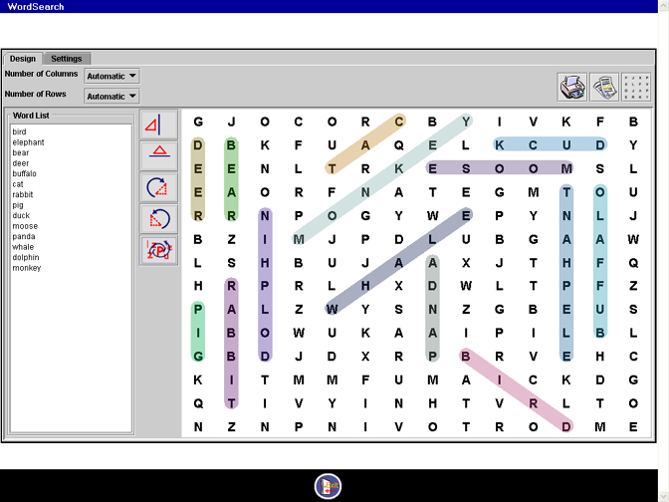
Prior Knowledge a.k.a. What They Already Know
Do they know how to identify targeted letter sounds in isolation and in context?
Do they know how to manipulate a word sort?
Do they know how to find letters or words in a word search?

Slide 6
First…Whole Class Practice!☺
Review targeted letter sounds
What sound does /or/ make? /Ar/? /Ur/?
What letters do you see for the “or” sound?
Pass out word cards with targeted letter sounds in them. (For example, far, car, fork, sort, fur, etc.)
Think – Pair – Share
“Read your card to your partner.”
“Read your card to your finger.”
“Read your card to the ceiling!”
Check for correct decoding!!! Check for understanding!!!
Allow about 2 – 3 minutes

Slide 7
Pocket Chart ready and labeled
ar or er/ir/ur
far Lorax Onceler

Slide 8
Next…Whole Class Sort
Bring students back together
Chose volunteers to begin class sort
As students bring their word to the pocket chart, ask them to read their word aloud to the class
THEN, have them place their word into the whole class sort

Slide 9
Introducing… Reader’s Theater Script
Have an enlarged copy of the Reader’s Theater Script ready and posted.
Review targeted letter sounds
Individually, have them “I Spy” (search) the text for words with targeted letter sounds in them
Have them turn to their partner and tell them a word(s) they found
(Allow about 2 minutes)

Slide 10
Reader’s Theater Scripts Teacher’s Copy Student’s Copy

Slide 11
Model highlighting a word
Have one volunteer tell you the word they see
Have student volunteers highlight word they see (Allow about 2 – 3 volunteers)
“Now its your turn to search for words on your own!”
Before handing out Reader’s Theater scripts, “check for understanding.”

Slide 12
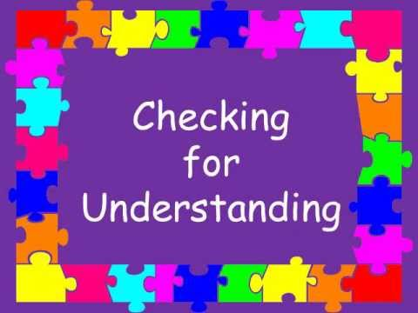
Check For Understanding
“What materials will you need?”
Students will reply “Our script, a highlighter…”
“Point to where you will find these materials.”
“You will have five minutes to work on this activity. How many minutes will you have?”
“When the timer sounds, what will you do?” “When you hear my voice, what will you do?”

Slide 13
Monitor Word Search!
Check on students that struggle with decoding, are lower level readers, easily distracted, etc.
As students highlight words, ask them, “How would you say this word, you highlighted?”
Check if students are highlighting the entire word or highlighting the targeted letter sounds
Call time; check if students need more time

Slide 14
Bring students back together
Ask students which words they highlighted
As students read words aloud, write them down on chart paper for future reference; this can be added to later as students learn more words that match the targeted letter sounds

Slide 15
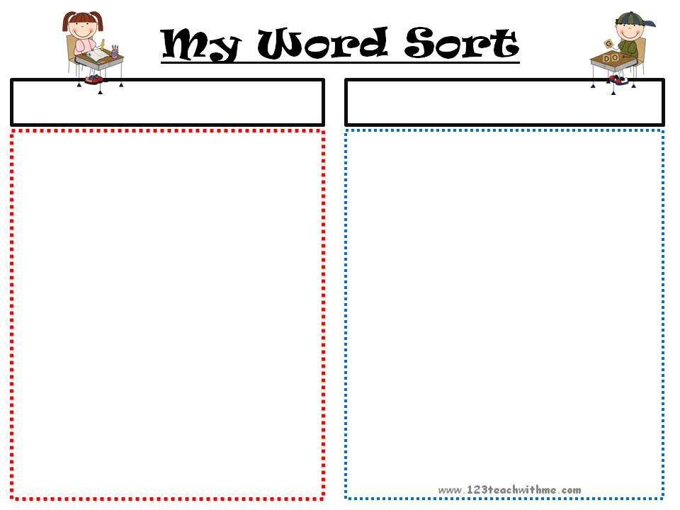
Introduce… My Own Sort
Using an enlarged photocopy of My Own Sort
Model writing words in the rectangles
Model copying words on to paper starting from the top of their page
Model tracking words while writing (let them use their fingers)

Slide 16
My Own Sort Teacher’s Copy Student’s Copy

Slide 17
“From where are you going to start writing your words?”
“What will help you keep your place while you write?”
“What words are you writing into these rectangles?”
“What materials will you need for this activity?”
“When the timer sounds, what will you do?” “When you hear my voice, what will you do?

Slide 18
Monitoring…
As students are writing words into their “My Own Sort” monitor for tracking
Check that students are writing one word per rectangle
As students transfer words from their scripts, to their “My Own Sort” paper, ask them “How do you read this word?” (Check for decoding!)
When students are finished looking for and writing words, have them cut up their “My Own Sort”

Slide 19
Extension Activities
After cuting up “My Word Sort”…
Use as continued practice activity
For example, alphabetize sort, category sort, etc.
As students master reading their words, have students complete a final sort, label and glue onto colored paper. Bulletin board idea! ☺

Slide 20
When and how to use this method
After spending time working on WTW sorts on
targeted phonics skill…
Before introducing Readers Theater script, targeting phonics in key vocabulary
For pre-reading Reader’s Theater scripts
To bring attention to targeted letter sounds in isolation and in context!
To bring attention to word families in isolation and in context!

